Slide 1



INTERNSHIP PRESENTATION
PRESENTED BY: Manish Rana
ENROLLMENTNO.: 2203051050730

Slide 2
OUTLINE
Introduction
Offer Letter
NOC
Completion Certificate
Flow Of Internship
Project Details
Implementation Snapshots
Conclusion
References

Slide 3
INTRODUCTION
My name is Manish Rana, and I am currently pursuing my final year in Computer Science from Parul University. I worked as a Java Full Stack at Spring Boot, where I gained practical experience in developing real-world applications. During my internship, my technical focus was on building scalable and
responsive web applications using modern technologies such as the using Java, Spring Boot, and OpenCV .
Company: Qspiders
Enrollment Number – 2203051050730
Location: Ahmdabad
Role: Java Developer
Training Starting Date: 2 Jan 2026
Training Ending Date: 10 April 2026

Slide 4
INTRODUCTION
Attendance management is a fundamental activity in educational institutions and organizations. It is used to track
the presence of students or employees and plays an important role in academic evaluation and organizational discipline. Traditionally, attendance is recorded manually using paper registers or basic digital systems. However, these methods are time-consuming, inefficient, and prone to errors.
With the rapid development of Artificial Intelligence (AI) and Computer Vision, automated systems have become more reliable and practical. Face recognition technology enables systems to identify individuals uniquely without physical contact, making the attendance process faster, more accurate, and secure.
The AI-Based Smart Attendance System is developed as a Java full stack web application to automate the attendance process using face recognition technology. The system is built using Java, Spring Boot, and OpenCV for backend processing and AI integration.
In this system, the camera captures live images, detects faces, and recognizes registered users. The backend processes the data and automatically marks attendance in a centralized database.

Slide 5
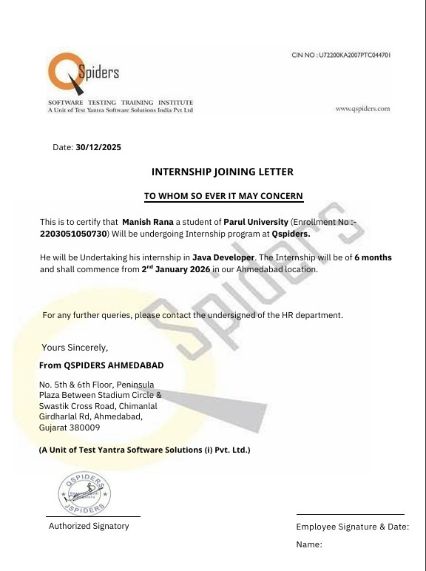
OFFER LETTER

Slide 6
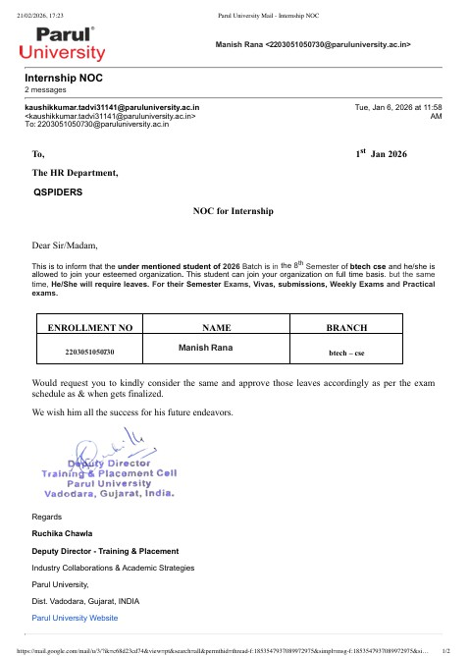
NOC - No Objection Certificate

Slide 7
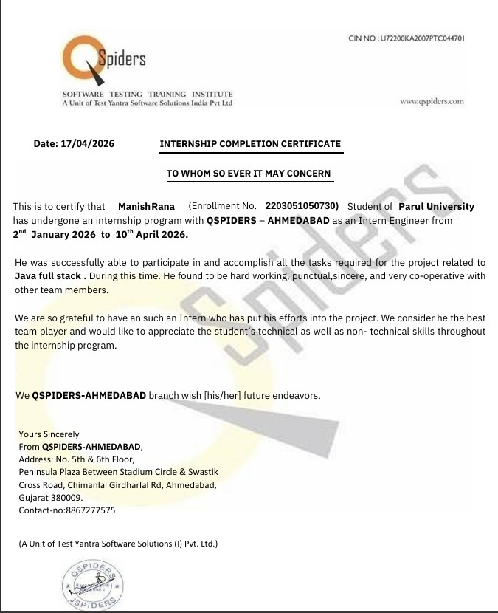
COMPLETION CERTIFICATE

Slide 8
FLOW OF INTERNSHIP
FLOW OF INTERNSHIP (Java Developer)
Introduction & Onboarding
Introduction to company workflow and development process
Understanding role as a Java Developer
Familiarization with project structure and team collaboration tools
Learning Phase
Basics of Java Programming (OOP concepts, syntax, core Java)
Understanding development tools (JDK, IDE like IntelliJ/Eclipse, Git)
Learning frameworks (e.g., Spring / Spring Boot basics)
Understanding code structure, debugging, and best practices
Developing logical thinking and problem-solving skills

Slide 9
FLOW OF INTERNSHIP
Development Phase – Project 1 (Java Application)
Designing application structure (modules, classes, architecture)
Writing clean and efficient Java code
Implementing features using Core Java / Spring Boot
Debugging and fixing errors
Testing and validation of application functionality
Practical Work
Working on real-world projects / applications
Building backend logic and APIs
Integrating databases (MySQL / MongoDB)
Improving code performance and efficiency
Following best coding practices and version control (Git)

Slide 10
PROJECT DETAILS
Java Development Work
The project involved developing a Java-based application with backend logic and system integration.
Designed and implemented modules using Core Java and OOP concepts
Worked on backend development using Java / Spring Boot
Handled data processing and storage using databases
Debugged and optimized code for performance and efficiency
AI Smart Attendance System (Web Application)
The AI Smart Attendance System is a web-based application that automates attendance using AI-based recognition techniques.
Developed backend using Java / Spring Boot
Integrated AI-based face recognition for attendance marking
Created APIs to handle user input and system processing
Connected application with database to store attendance records
Implemented features like student registration, attendance tracking, and report generation
Ensured accuracy and reduced manual effort in attendance management

Slide 11
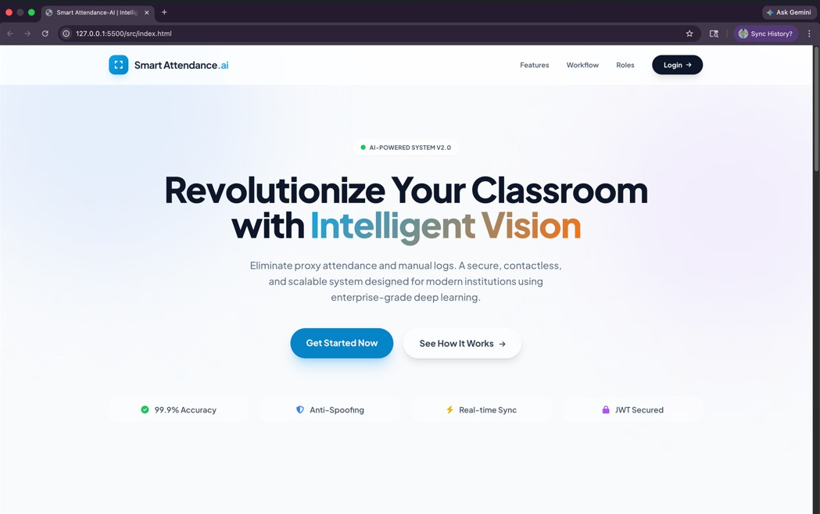
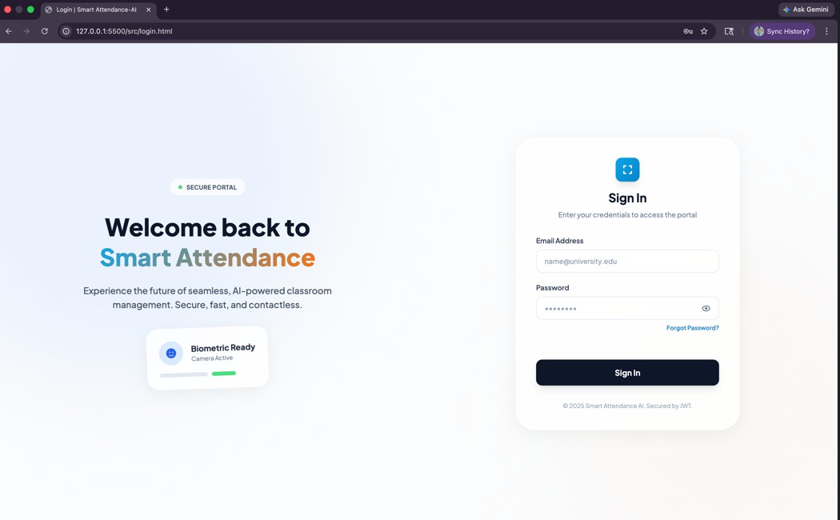
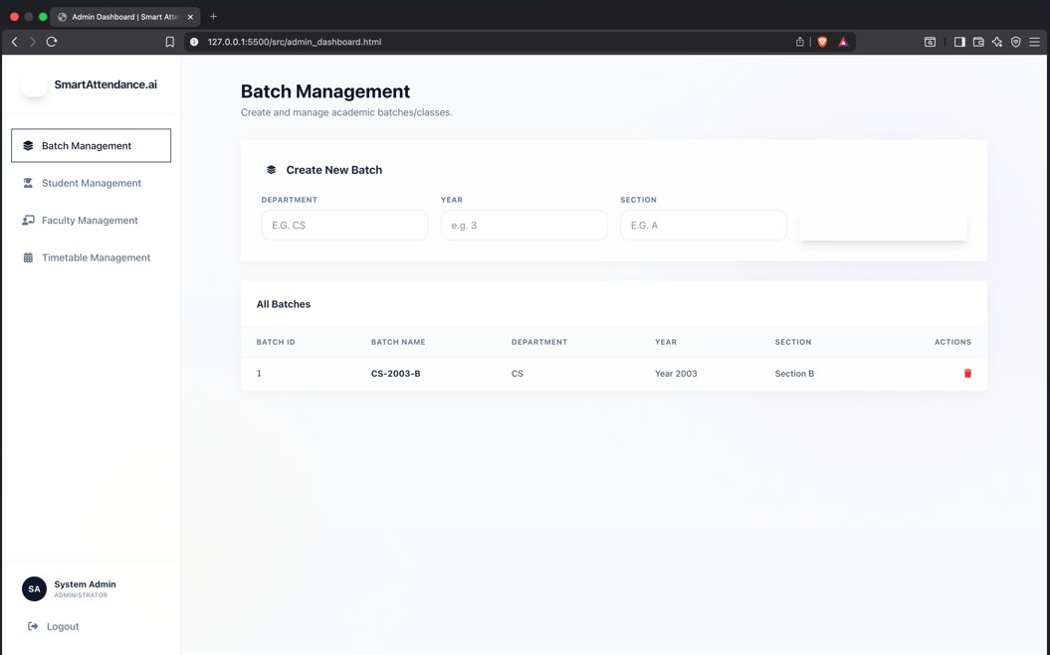
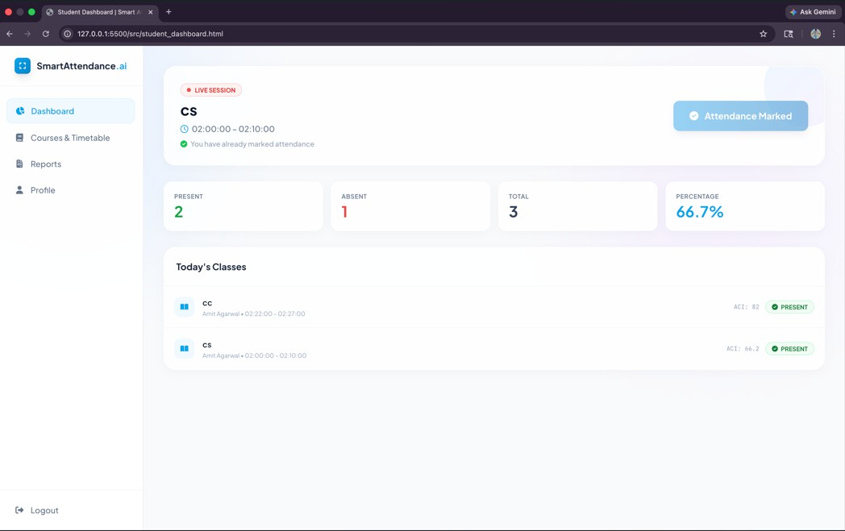
IMPLEMENTATION SNAPSHOTS

Slide 12
CONCLUSION
The successful completion of this internship marks an important milestone in my
academic journey. This internship provided valuable exposure to Java full stack development and real-world application building.
During the internship at Agile Technologies, I worked on backend development, web application design, and project implementation tasks. I gained hands-on experience in Java programming, Spring Boot framework, database integration, and API development. This internship improved my problem-solving skills, coding efficiency, and understanding of real-world software development processes. I also learned how to build scalable applications and follow best coding practices.

Slide 13
THANK YOU

